Slide 1
Get Dat Donut
Gertrude Beyl
Clint Caudle
Nolan Smith

Slide 2
Our First Idea
Messaging app requiring completion of a task to open the message
Game involves touch to set direction of moving object
Object has goal location, when reached message pops up

Slide 3
First Cycle
As beginner programmers who never before attempted app development, we focused on a “Hello World” app for the first cycle.
This easy implementation of code helped us to focus on the file-linking process. Initially, we over-complicated the process. We downloaded far too many programs (see next slide).

Slide 4

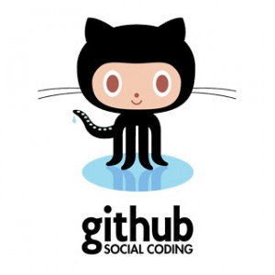
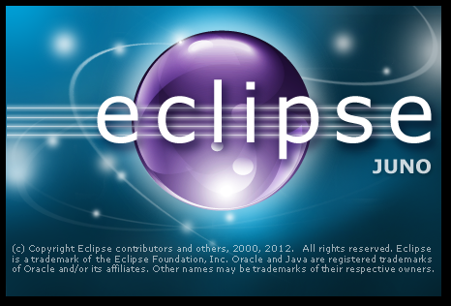

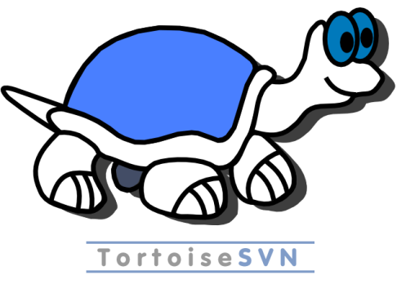



Wasted memory…

Slide 5
Not quite sure why it took so long…
But we finally realized we could just use the following for our programming:
Eclipse Juno
Android SDK Tools

Slide 6
Intermediate Cycles/Issues
We spent the rest of the cycles working more specifically on our app. One issue we came across was simply remembering how to code in Java from CS101. The “this” keyword and lack of pointers make a huge difference when compared with programming in C++. However, these syntax rules were one of the easier obstacles to overcome. We had many decision to make concerning the implementation of the game…

Slide 7
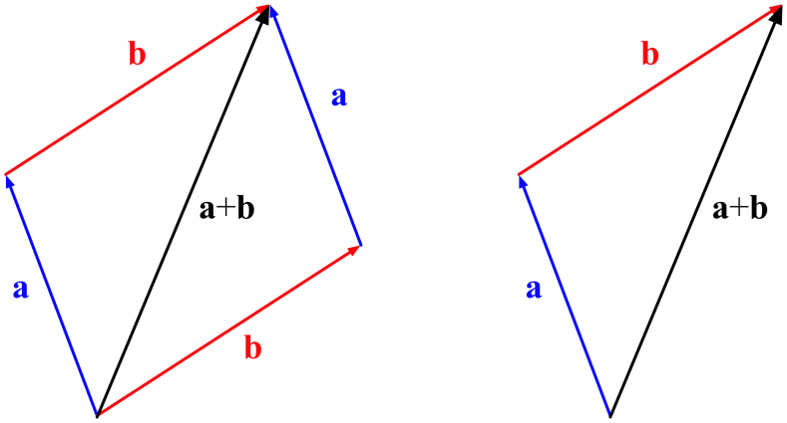
How to represent a “move”
Problem: we decided that a touch of the screen causes the moving object to change direction to the spot touched, but how fast? And how do we implement this?
Solution: we implemented a vector class so that we can use vector arithmetic to represent movement. The “Droid” object has vectors for both position and velocity.

Slide 8
How to support different “modes”
Problem:
Solution:
We wanted to make the response to a touch have different behaviors. “Repulse” would send the object in an opposite direction, “attract” would send the object towards the touch, and “orbital” would use a circular motion.
We implemented a Strategy pattern. Therefore, each “Droid” object has a strategy data member representing the behavior of a response to touch. This not only makes the game more interesting, it also makes it extensible for different modes in the future.

Slide 9
In conclusion
As we were figuring out the game, we realized incorporating messaging was probably not going to happen…we hope to work on this in the future. Even after learning so much, we’re still amazed by the amount we have yet to know. We leave this semester not only with a new game to distract us in class, but with a desire to explore other aspects of designing mobile applications!

